Slide 1


COMMUNICATION DESIGN PROJECT
Team Starlink
BASNAYAKE B.M.N.S. 220072R
PELAGEWATTA H.P. 220455U
PATHIRANA P.N.A . 220449F

Slide 2

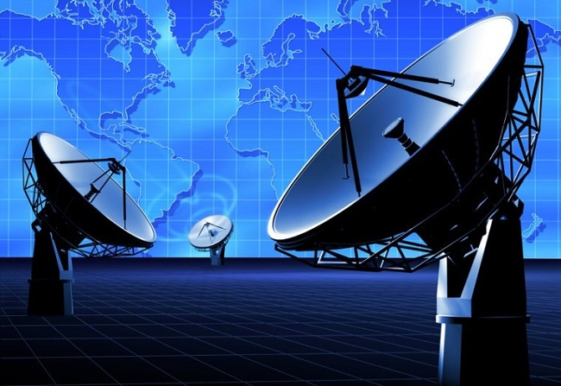
PROJECT OVERVIEW
Objective: Develop a point-to-point communication system that can transmit images, voice, and video wirelessly in the 2.4 GHz ISM band.
Key features:
Digital modulation techniques
GNU Radio for signal processing
BladeRF for hardware implementation

Slide 3
DESIGN METHODOLOGY
REQUIREMENT ANALYSIS
SELECTION OF MODULATION SCHEME
IMPLEMENTATION IN GNU RADIO.
1
2
3
Point-to-point digital wireless communication system in 2.4 GHz ISM band.
Should be able to transmit images, voice and video
Selecting QPSK for higher data rate and bandwidth efficiency
Identifying blocks and their arrangement.
Designing the flowgraph.
Simulate transmission with virtual channel model.

Slide 4

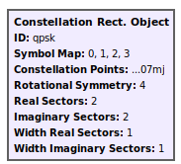
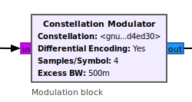

WHY QPSK?
High Bandwidth Efficiency: Transmits 2 bits per symbol.
Spectral Efficiency.
Doubled data rate over BPSK.
Balanced tradeoff between complexity and performance than BPSK
Similar power efficiency in practice to BPSK

Slide 5
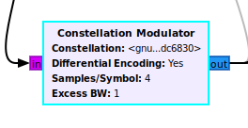
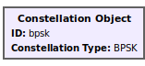
BPSK
Simplicity: Easy to implement and debug.
Less bandwidth efficient than QPSK.
Robustness: Performs well in noisy environments with low bit error rates.
Power Efficiency: Operates effectively at low power.
Simple Receiver: Straightforward design for modulation and demodulation.

Slide 6
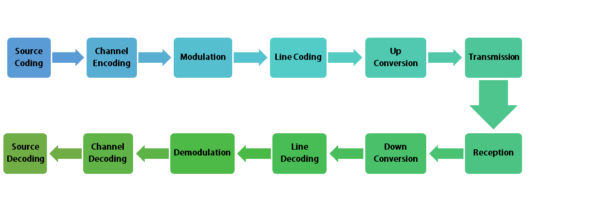

BASIC IDEA OF THE FLOWGRAPH

Slide 7
DESIGN METHODOLOGY
HARDWARE SETUP USING BLADERF
IMPLEMENTING
POINT TO POINT TRANSMISSION
TESTING AND PERFORMANCE OPTIMIZATION
4
5
6
Updating the flowgraph based on the errors encountered when transmitting point to point through a real channel
Transmitting through a real channel with the use of BladeRf
Using 2 devices to implement the point to point communication system

Slide 8
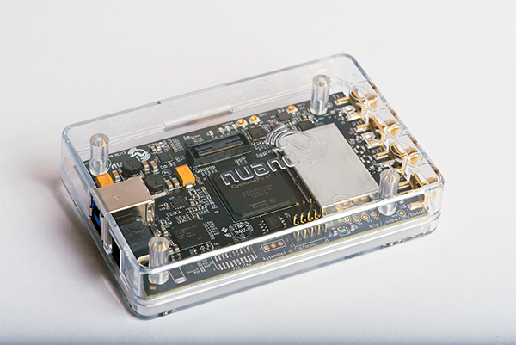
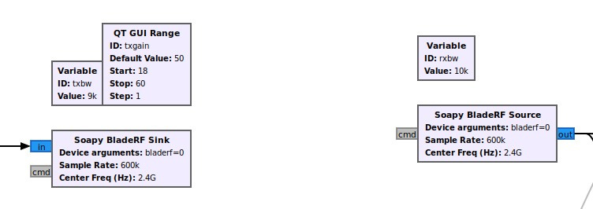
WIRELESS COMMUNICATION USING BLADERF
We utilize the BladeRF device for wireless communication, opting for practical implementation over simulation by using the SoapyBladeRF Source and SoapyBladeRF Sink blocks into the flowgraph to directly interface with the BladeRF hardware.
SoapyBladeRf Sink Block
is used to transmit processed data via the BladeRF device. This block sends the modulated signal to the BladeRF for transmission.
SoapyBladeRf Source Block
is used to receive signals from the BladeRF device. This block captures incoming signals from the air and allows processing them for further operations.

Slide 9
CHALLENGES ENCOUNTERED
Timing mismatches caused decoding errors (when transmitting images). Resolved this by adding a preamble.
SYNCHRONIZATION ISSUES
CHANNEL INTERFERENCE
Interference from Wi-Fi and Bluetooth degraded signal quality.
Noise in the channel introduced data errors. We addressed this with robust error detection and correction codes.
ERROR HANDLING

Slide 10
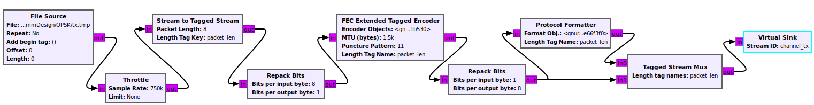
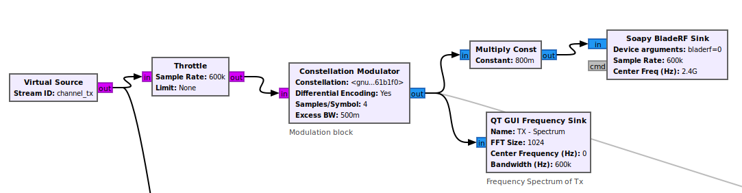
TRANSMITTER FLOWGRAPH

Slide 11
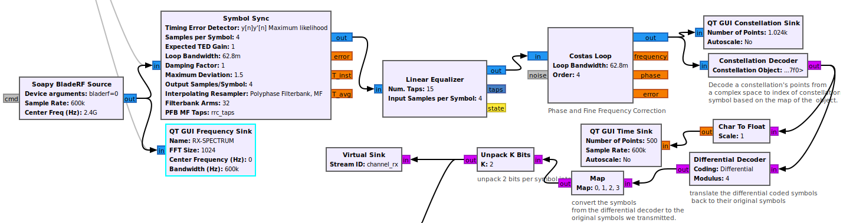
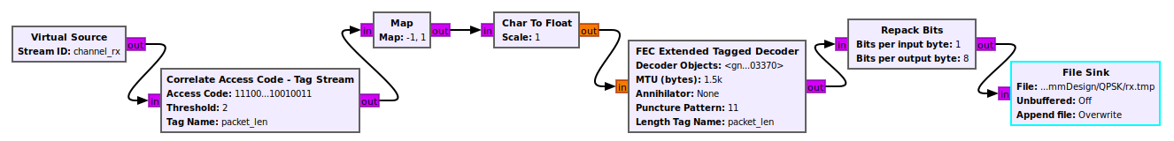
RECEIVER FLOWGRAPH

Slide 12
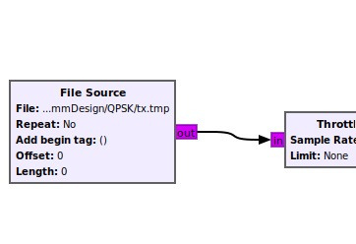
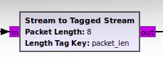
FILE SOURCE
We used the File Source block to get the bit stream input.We take any input as a tmp file. This is done by a custom python code in the directory.
Key Features:
Converts the input source into characters and then a header and a tail is added to identify the beginning and the end .
A preamble and a filler is also added for synchronizing purposes .
This method is used to protect the meta data(File formats etc).
STREAM TO TAGGED STREAM
The Stream to tag Stream block converts a continuous stream of data into packets of 8 bytes by adding tags. This define the start and end of a packet.
This packetizing step for the following framing process.

Slide 13
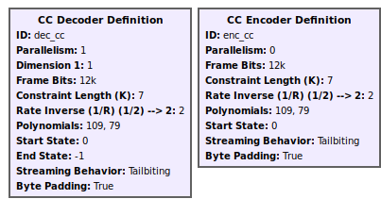
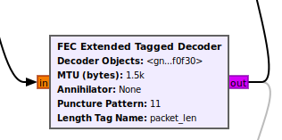
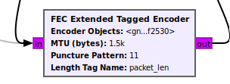
FORWARD ERROR CORRECTION
The FEC Extended Tagged Encoder and Decoder blocks in GNU Radio implement Forward Error Correction (FEC) using tagged streams.
FEC Extended Tagged Encoder
Adds redundancy to the input data based on convolutional codes. This redundancy helps detect and correct errors during transmission.
FEC Extended Tagged Decoder
Uses the redundant information to identify and correct errors in the received data, improving reliability.
Parameters: Constraint length-7 , Rate-1/2

Slide 14
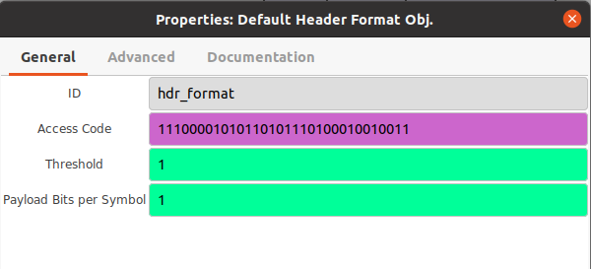
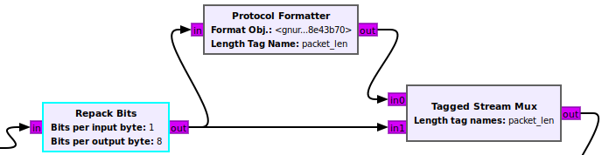
FRAMING
The Protocol Formatter block generates a header using a specified format and appends it to the tagged stream. Here we use a 32 bit (4 byte) access code.
The Tagged Stream Mux block combines the payload stream and the generated header stream into a single stream.

Slide 15
CONSTELLATION MODULATOR
The constellation modulator block modulates a stream of bits into complex baseband symbols. It has the following parameters.
CONSTELLATION
Defines the modulation type using a modulation object. Here we use QPSK. So, we map the bits to 4 symbols with 2 bits per symbol.
DIFFERENTIAL ENCODING
SAMPLES/SYMBOL
Here we set differential encoding to ‘Yes’
This upsamples the symbols with a factor of 4
EXCESS BANDWIDTH
Uses a root-raised cosine (RRC) filter with a roll-off of 0.5Hz for pulse shaping. This helps to minimize inter-symbol interference (ISI).

Slide 16
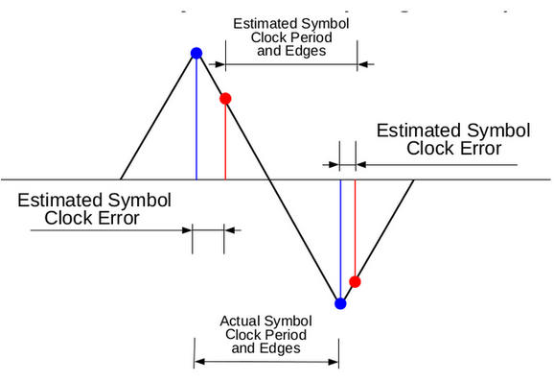
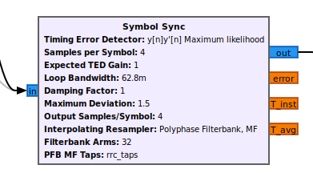
USING SYMBOL SYNC BLOCK
The Symbol Sync block is used for accurate clock recovery and synchronization of symbols in the received signal. It adjusts for timing offsets and ensures symbols are correctly sampled at their optimal points.
Why Used Instead of Polyphase Clock:
Flexibility: Symbol Sync supports various synchronization algorithms, offering better adaptability to different modulation schemes like BPSK.
Ease of Configuration: Provides a simplified interface for fine-tuning parameters compared to the more complex polyphase clock approach.
Improved Performance: Offers higher accuracy and stability in symbol timing recovery, essential for reliable data decoding in your project.

Slide 17

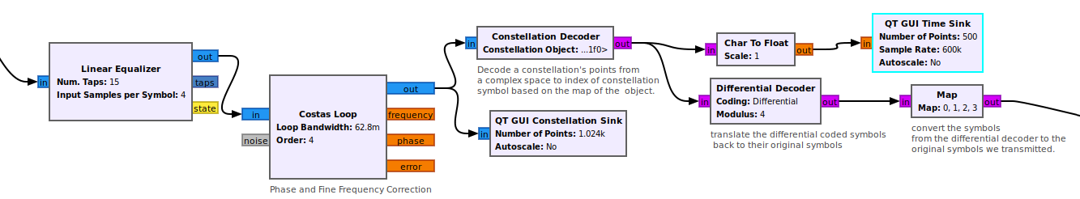
1
The Linear Equalizer block compensates for channel distortions like multipath fading or inter-symbol interference (ISI). Here it uses a CMA algorithm (Constant Modulus Algorithm). This corrects the error of diffrent amplitudes in the constellation diagram.
3
The Constellation Decoder block Maps received complex symbols back to their corresponding bit sequences according to QPSK modulation we defined earlier.
2
The Costas Loop block is used for carrier frequency and phase synchronization. It tracks and corrects phase offsets in the received signal.
The Differential Decoder block decodes data that was encoded using differential encoding. It recovers the original bit sequence by comparing the phase or state changes between consecutive symbols.
4

Slide 18
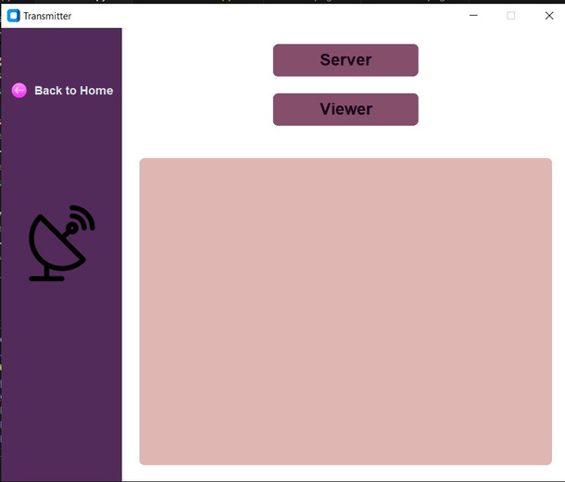




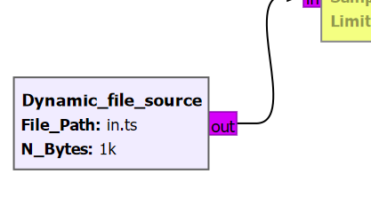
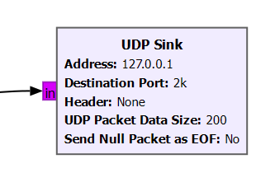


STREAMING
Transmitter Side-
The VLC media player is given access to the camera and the input video stream is saved as in.ts file and constantly updated
The file is repeatedly read and sent through the transmitter.
Reciever Side-
The received data is read and it is displayed through the receiver side VLC

Slide 19
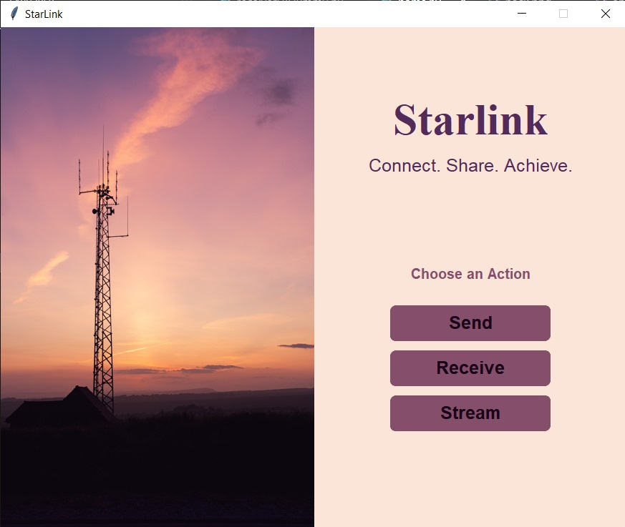
GUI
The user interface is developed using python and customtkinter library.
You can Send, Recieve or Stream

Slide 20
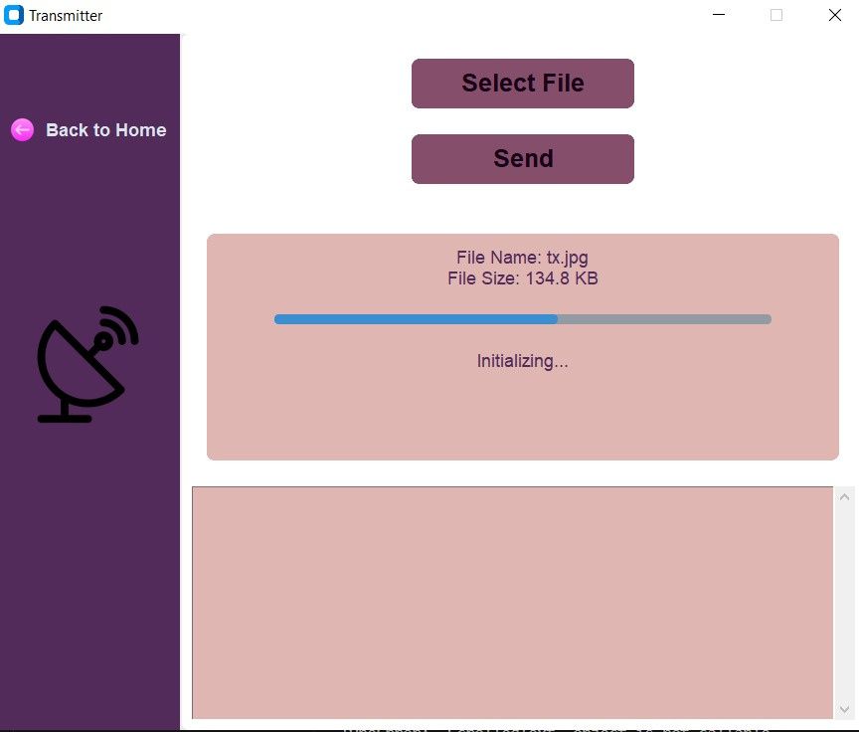
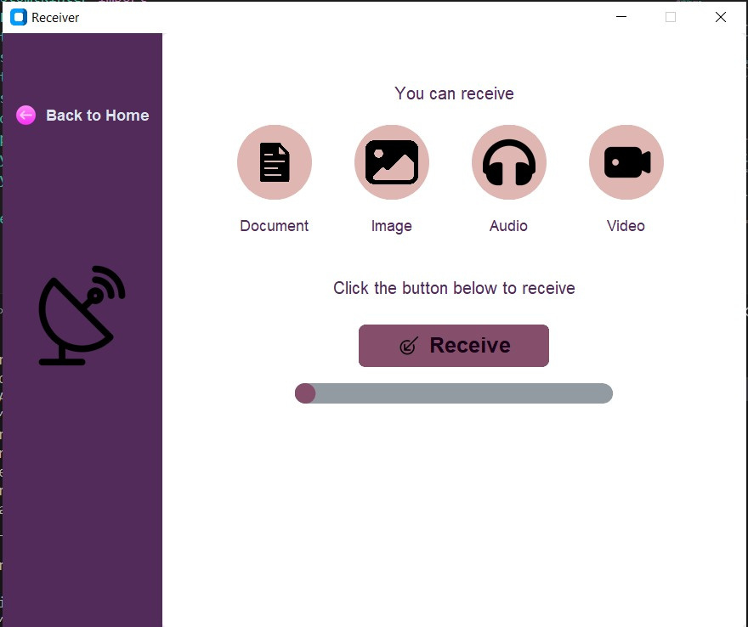
Sending And Receiving GUI’s

Slide 21
PERFORMANCE FIGURES
Maximum distance that can be transmitted: 40-45 ft
We tested the point-to-point communication system at various distances and ensured reliable and accurate data transmission up to around a distance of 45 feet
Data Rate between 196-226 kbps
We transmitted a file of known size and measured the time taken for its transfer to determine the data rate of the communication system.

Slide 22
THANK YOU

